Slide 1
Systematic Analysis of Variant Effect Maps
BCB330 Final Presentation
Bilin Nong
Supervisors: Jochen Weile & Fritz Roth
@ the Roth Lab

Slide 2
Outlines
Background
Introduction
MAVEs: a proactive approach
Issues related to MAVEs
New pipelines vs. Old pipelines
Objectives
Results
SUMO1
CALM1
MTHFR

Slide 3
Background
Interpretation of clinical variants
ACMG guidelines (P, LP, B, LB, VUS) → classify variant effect
Majority of clinical variants → VUS (Variant of uncertain significance)
Variant Classification Methods
In silico Methods
Laboratory Assays
Notes:
Linking genotype to phenotype is a complex problem.

Slide 4
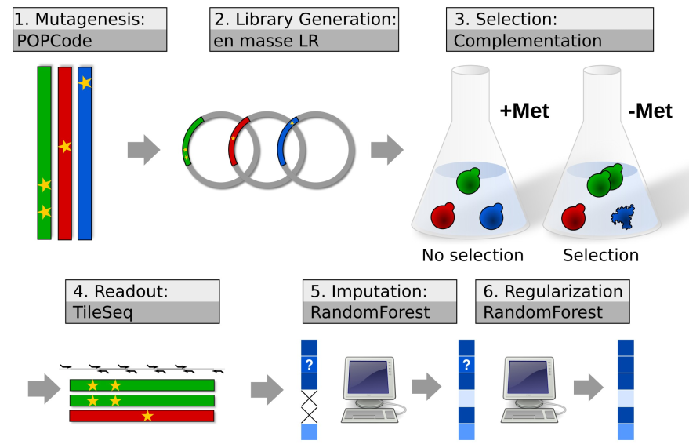
MAVEs (Multiplex Assays of Variant Effect)
Thanks to Jochen for making the graph!

Slide 5
Issues with MAVEs
Not straightforward clinical interpretations → LLR Approach
Different versions of MAVEs → varying outcomes
Old version of MAVEs pipelines vs. New version of MAVEs pipelines
…

Slide 6
Objectives
1. Re-process the raw data underlying existing variant effect maps with the latest versions of their respective analysis pipelines.
2. Evaluate the performance of different versions of MAVE pipelines with respect to precision and sensitivity on reliable benchmarks.

Slide 7
Results
SUMO1
CALM1
MTHFR

Slide 8
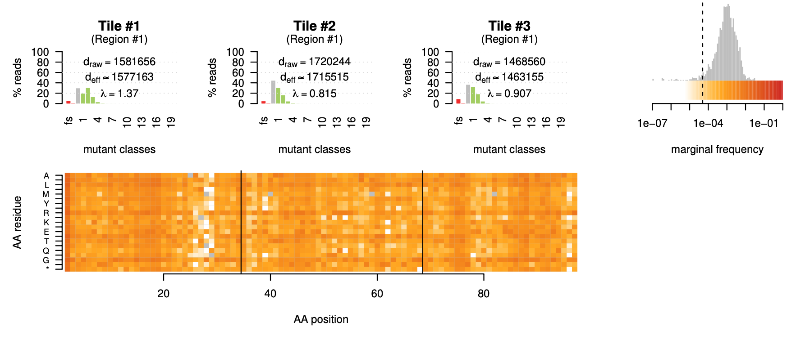
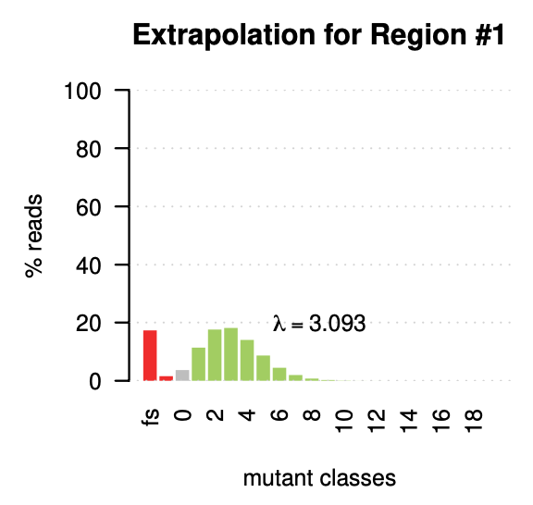
SUMO1: QC Results

Slide 9
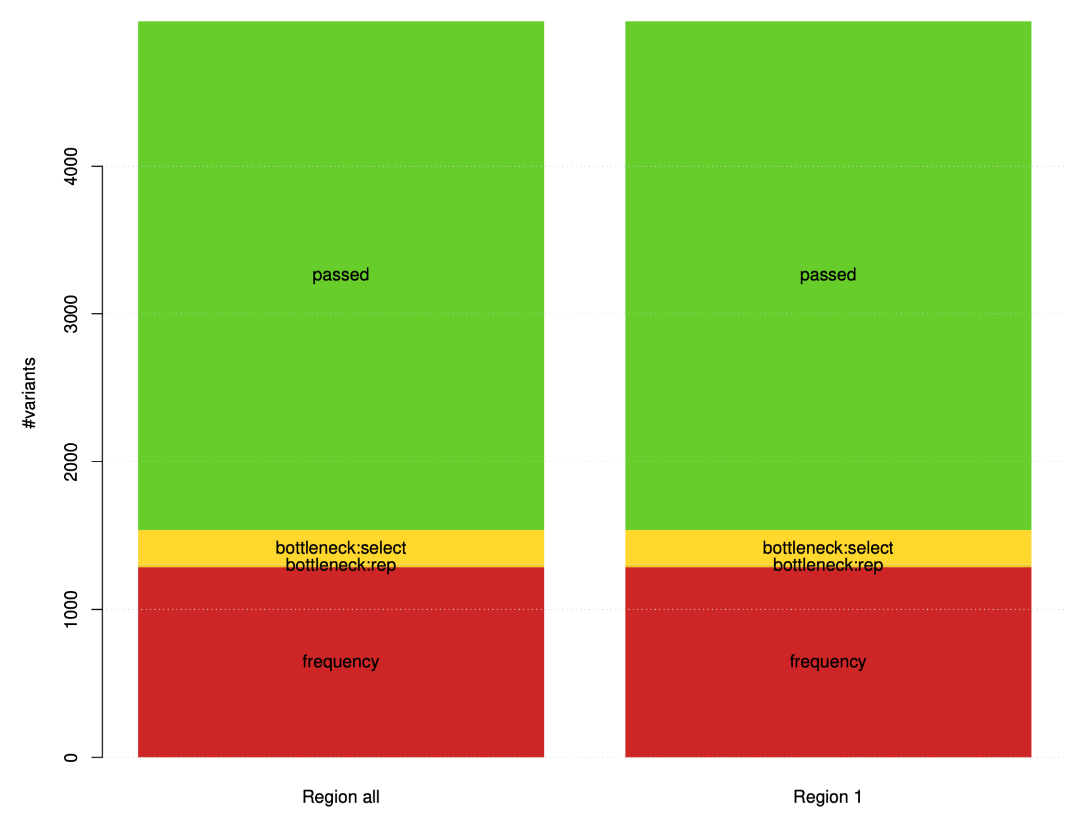
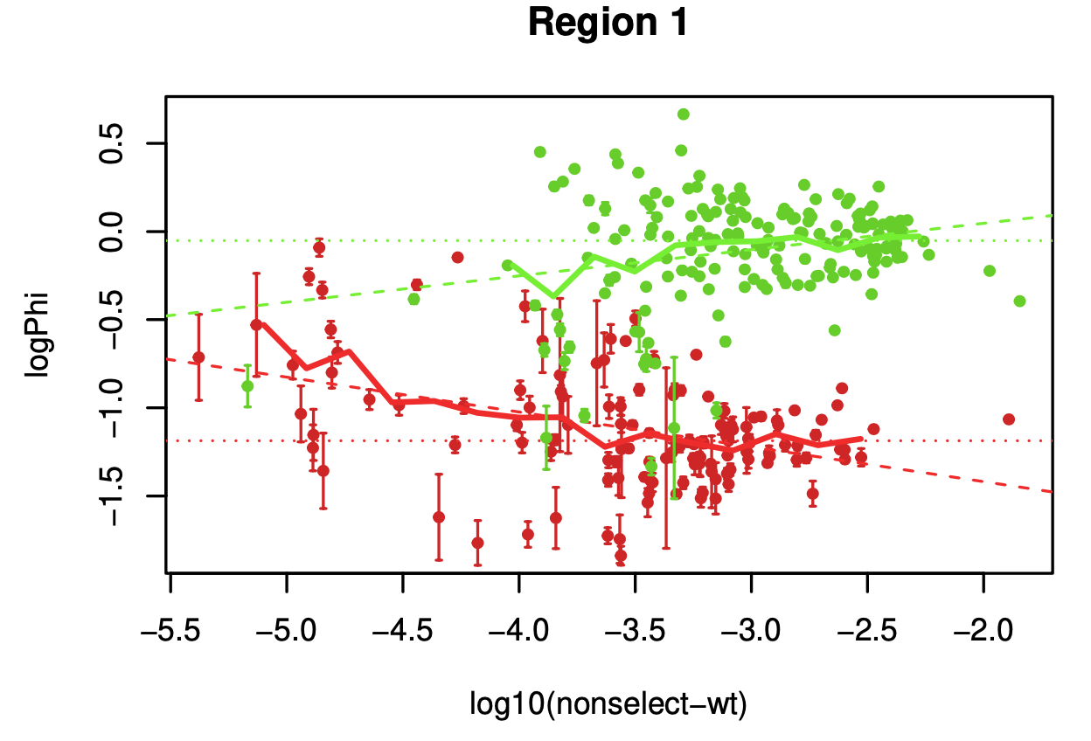
SUMO1: QC Results

Slide 10
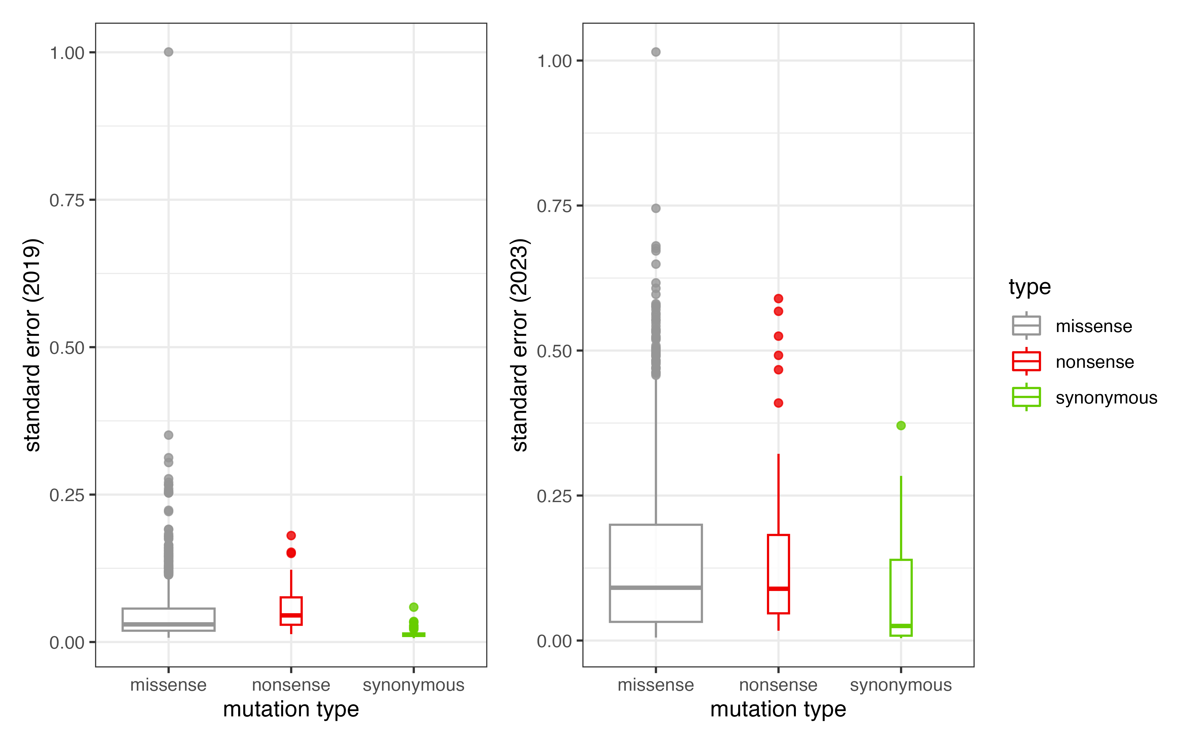
SUMO1: Score 2019 vs. Score 2023

Slide 11
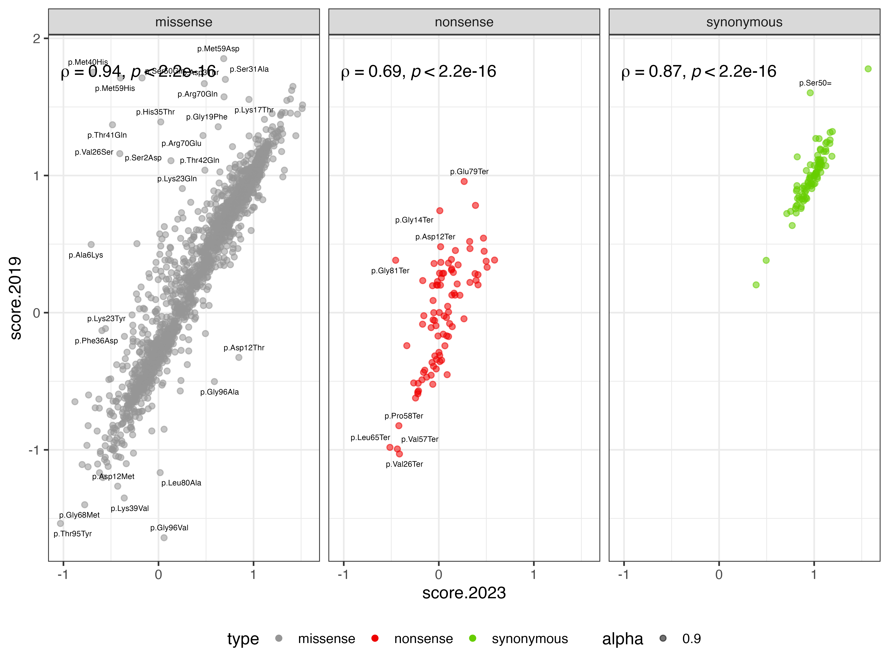
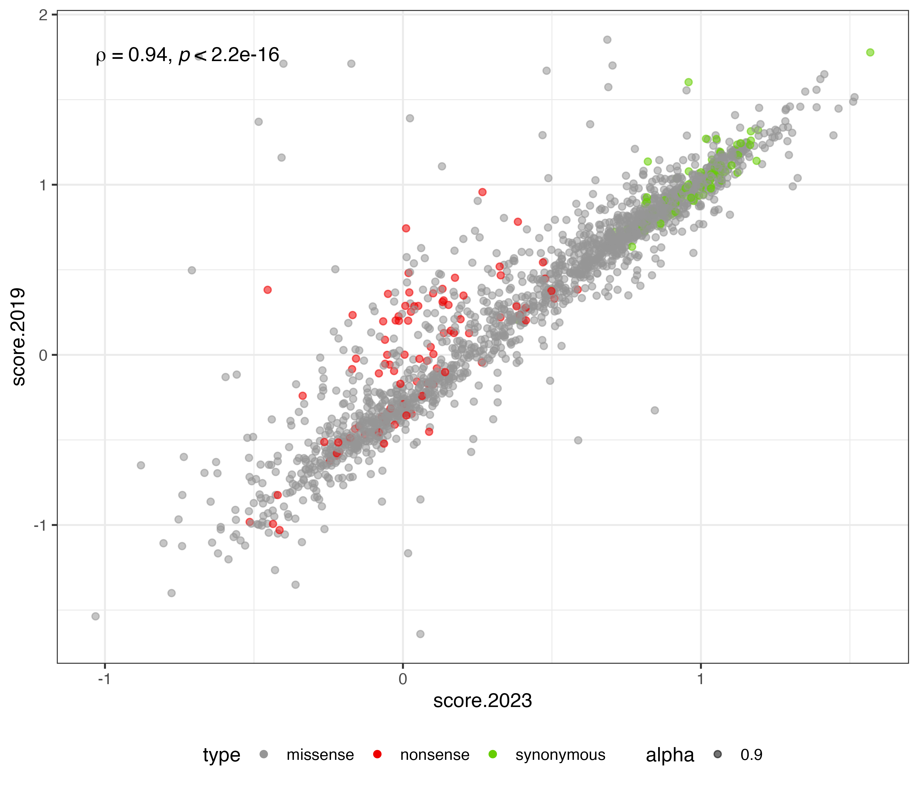
SUMO1: Score 2019 vs. Score 2023

Slide 12
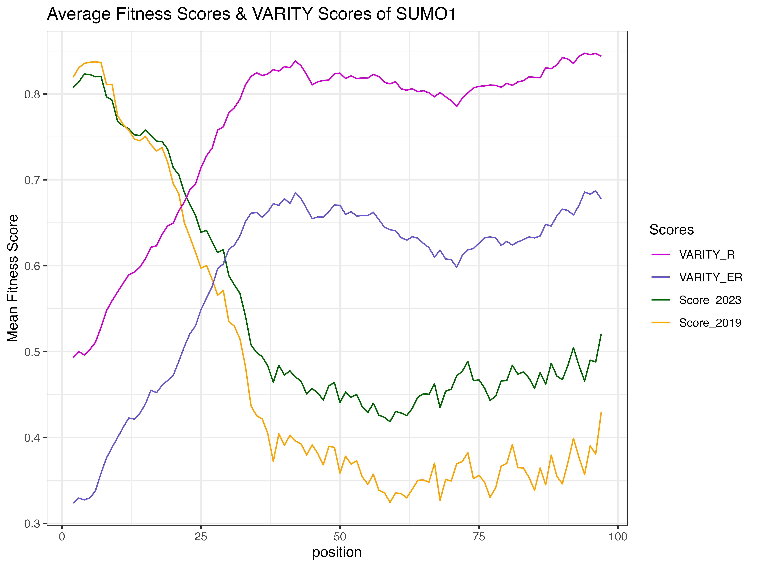
SUMO1:Map Scores vs. VARITY Scores
VARITY: produce a probability of pathogenicity (scale oppositely to fitness)

Slide 13
SUMO1:Map Scores vs. VARITY Scores
Spearman correlation coefficient
Conclusion?

